Slide 1
Status Update Meeting
Design and Development of DSCAN: Malware Detection and Prevention for Drone Data
Principal Investigator: Dr. Padmalochan Bera,
Associate Professor (CSE), School of
Electrical & Computer Sciences, IIT Bhubaneswar
Team: Kasturi Routray and Sangam Mishra

Slide 2

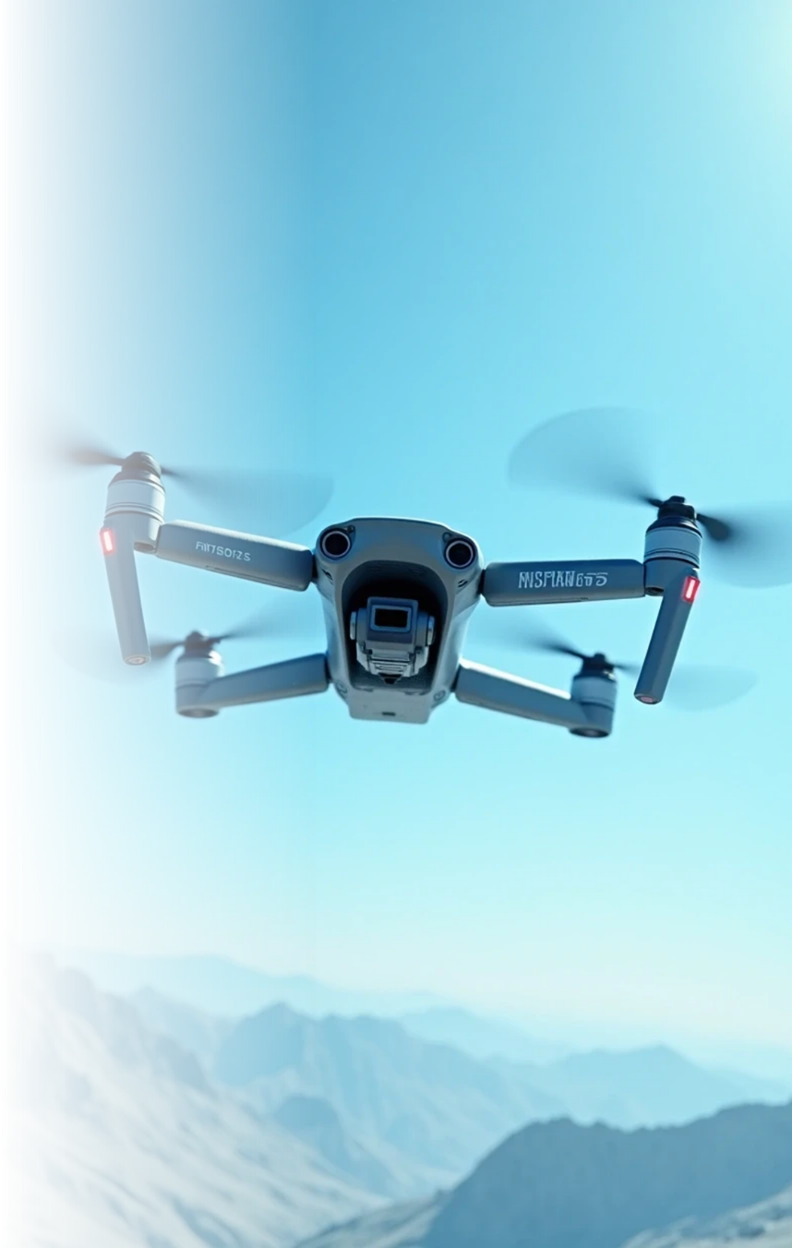
Project Objectives
Detect and Block Malicious Payloads
Device Authentication and Metadata Validation
Risk-Based Adaptive Inspection
Intelligent Defense via AI and Game Theory
Visibility and Auditability
Real-Time Operational Performance

Slide 3
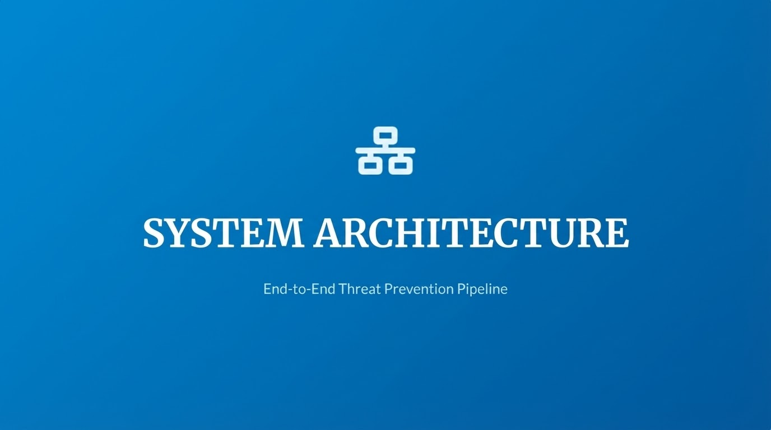

Slide 4
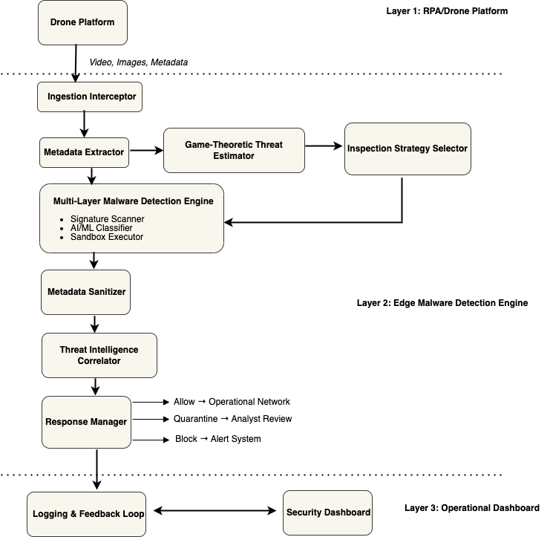
Proposed Architecture

Slide 5
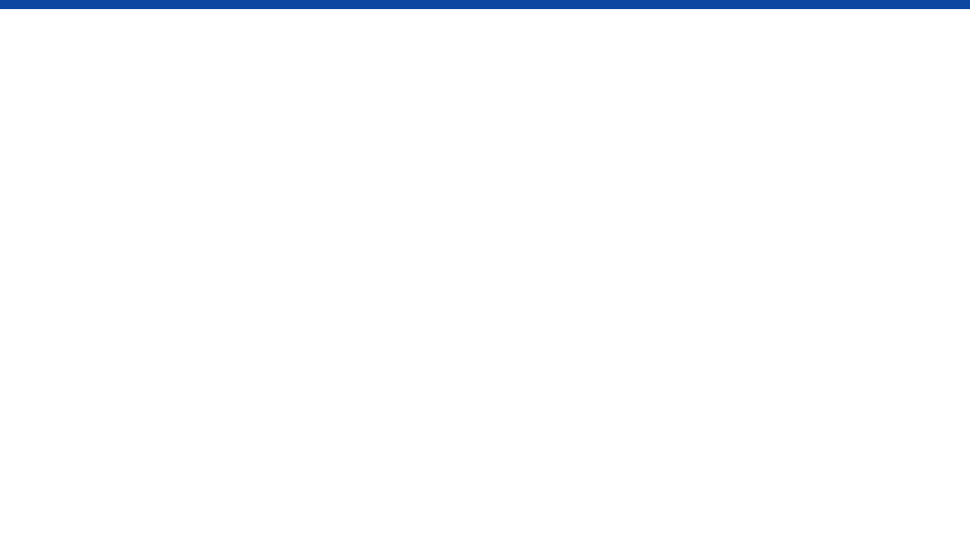
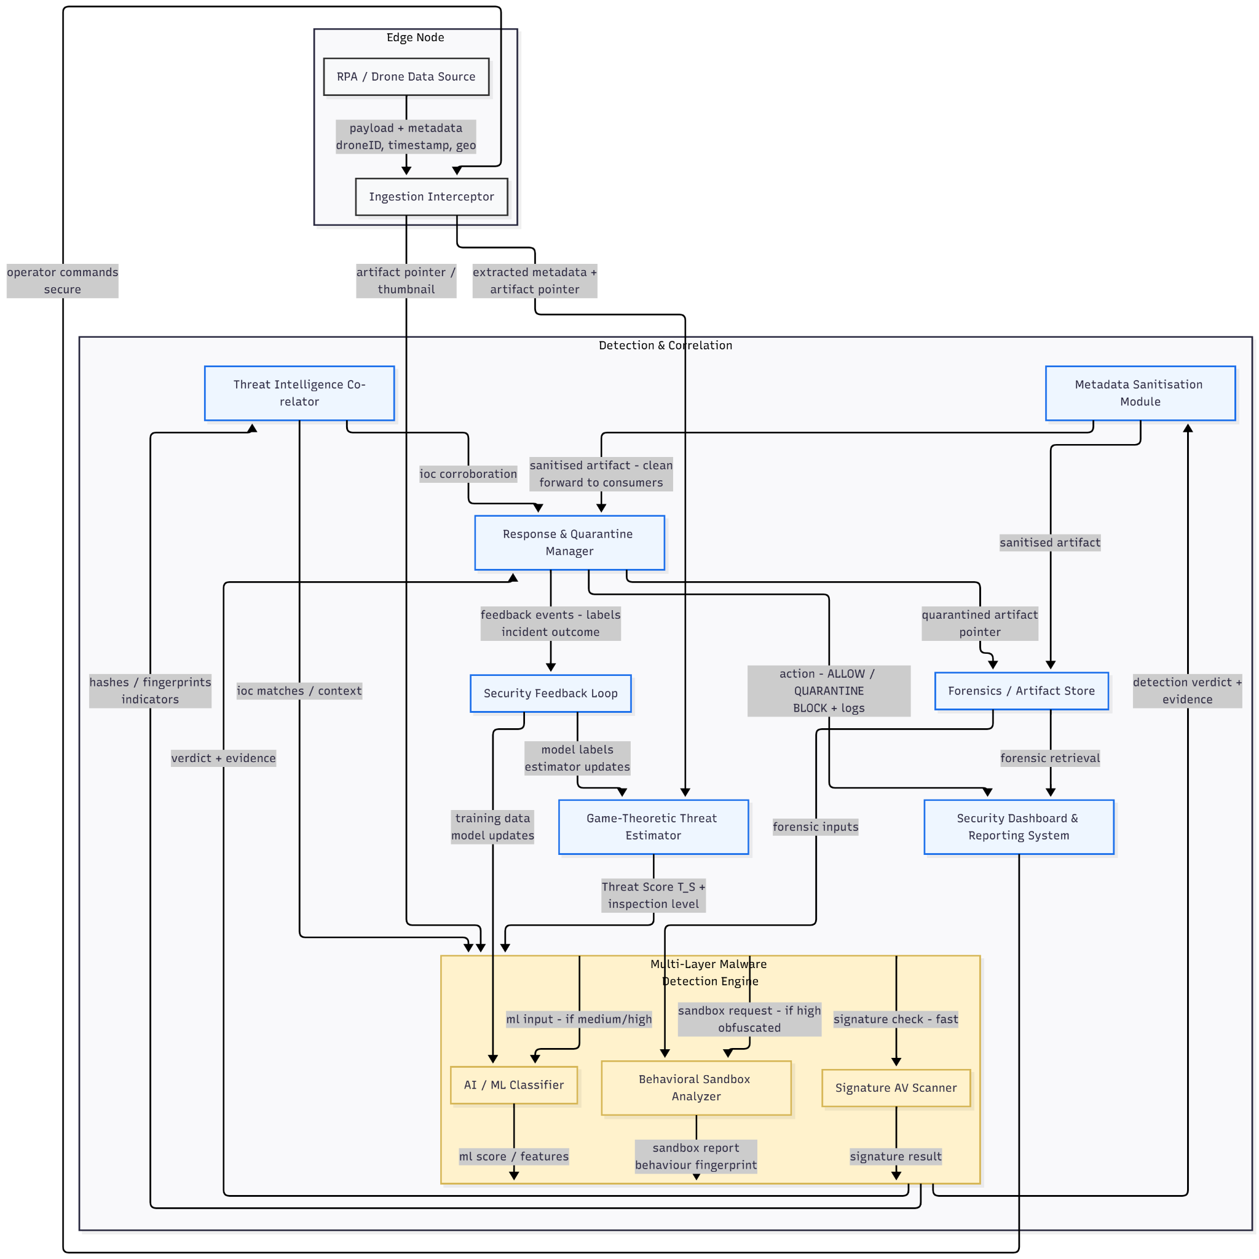

Slide 6
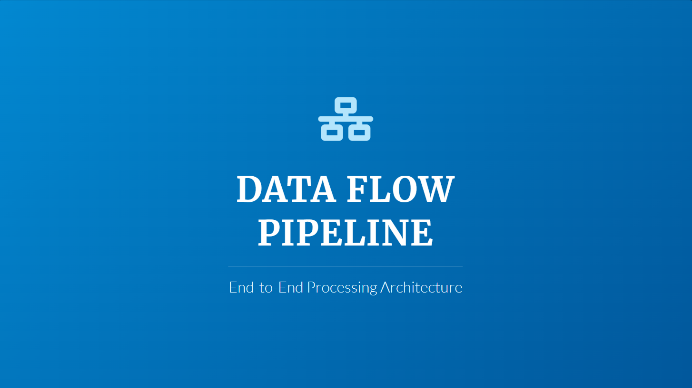

Slide 7
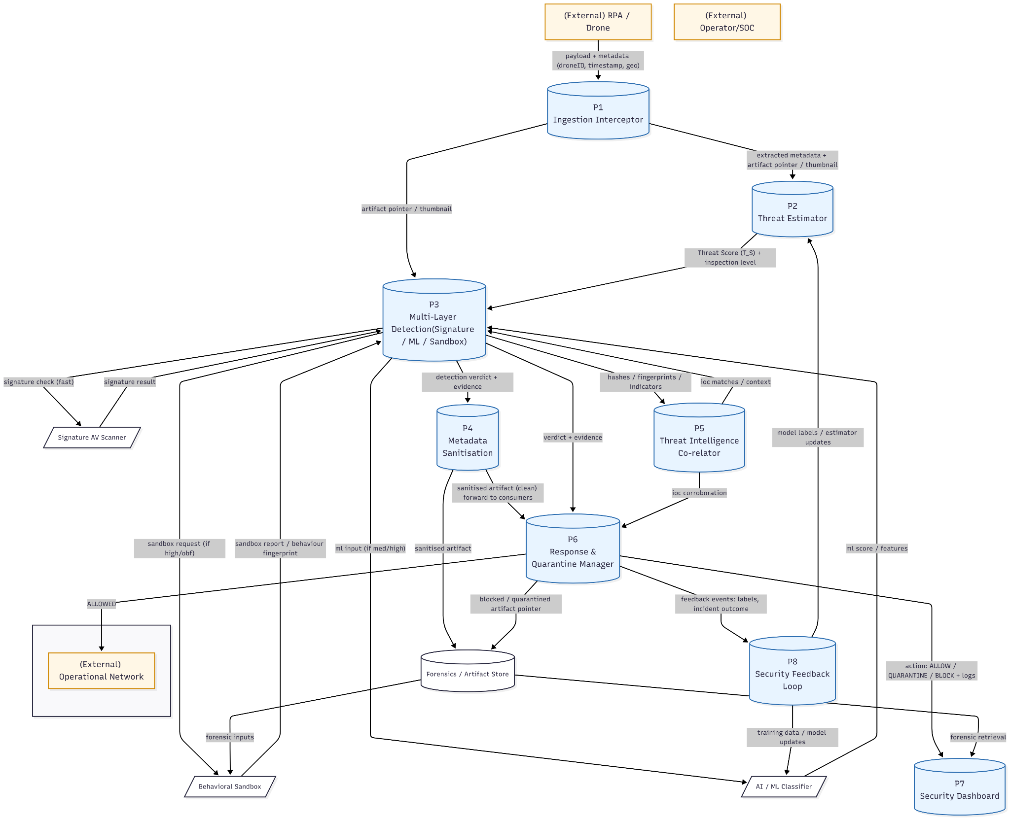

Slide 8
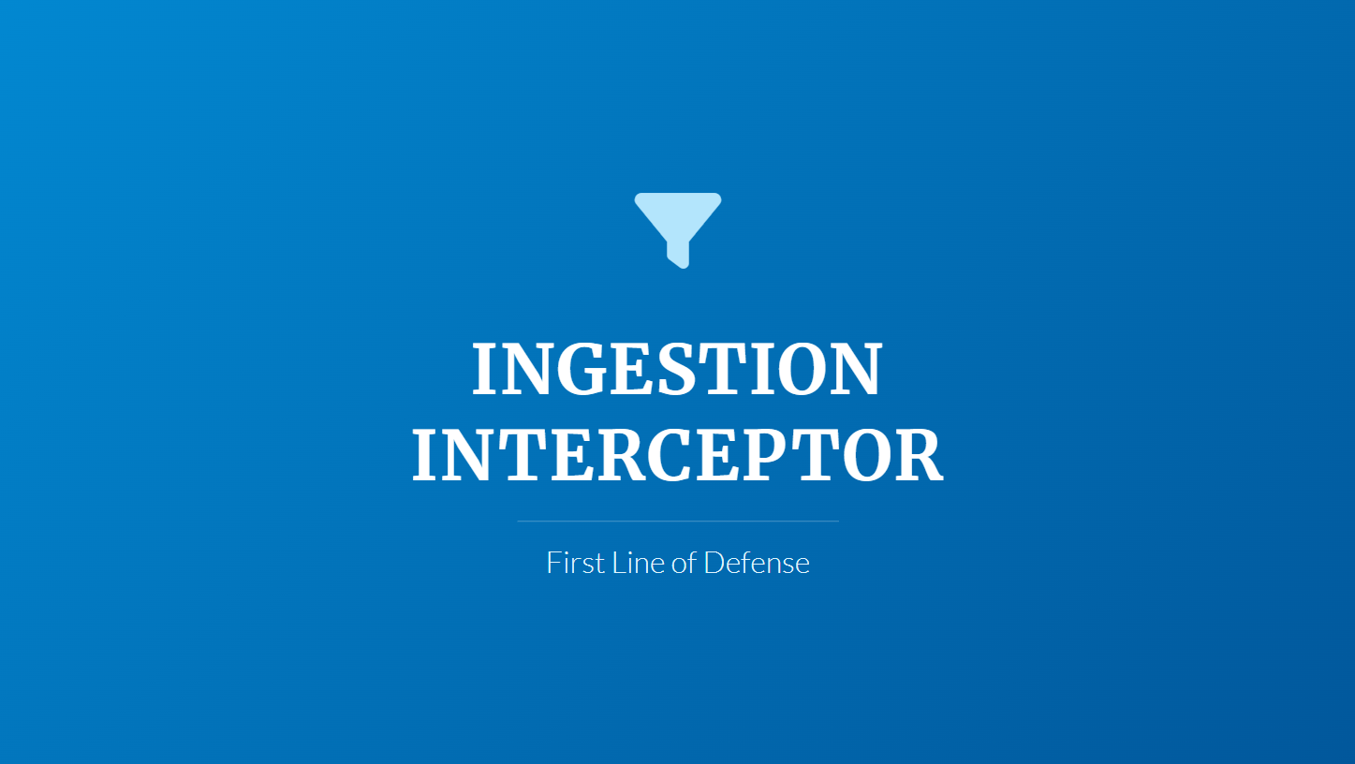

Slide 9
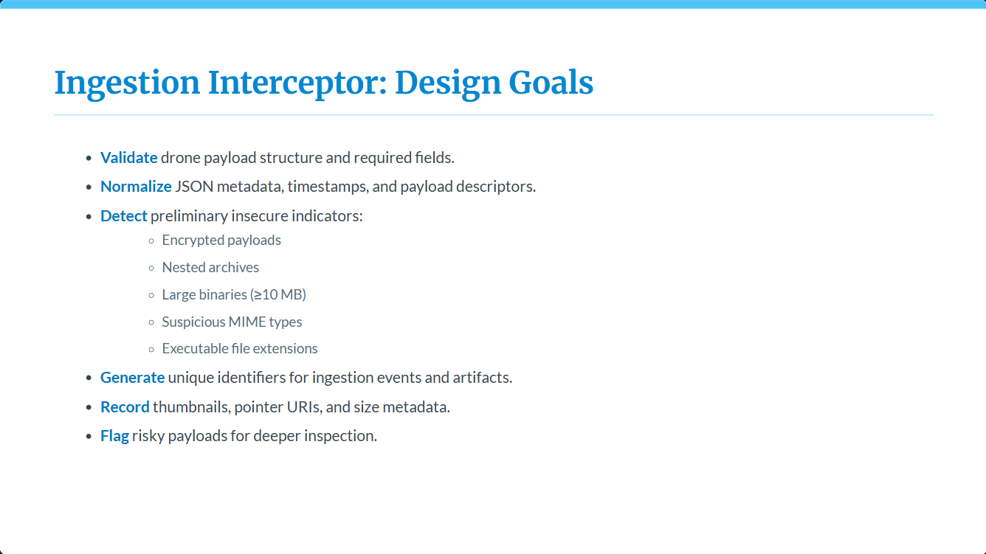

Slide 10
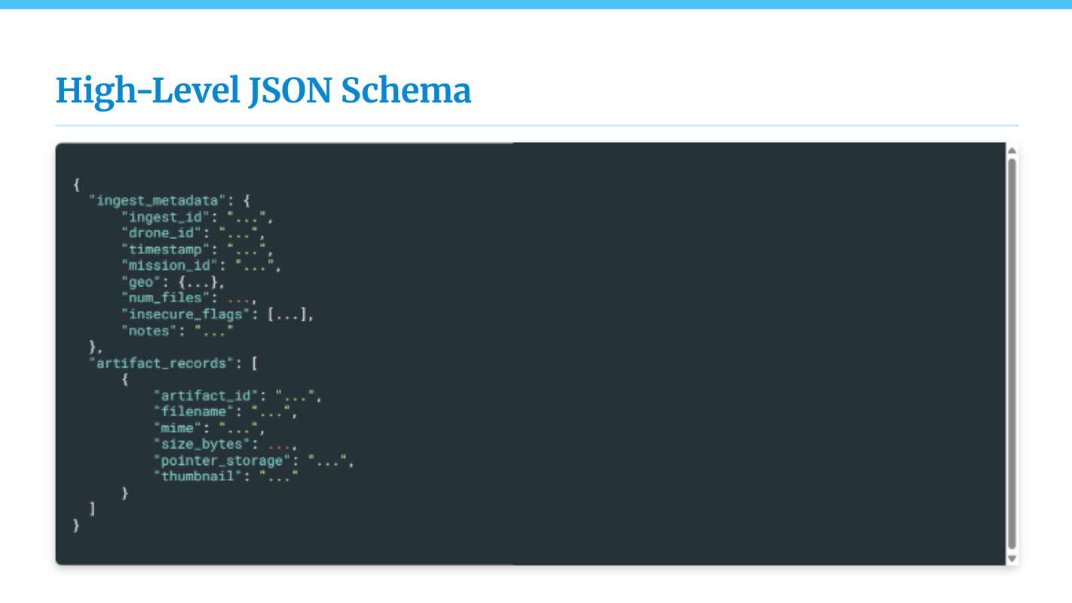

Slide 11
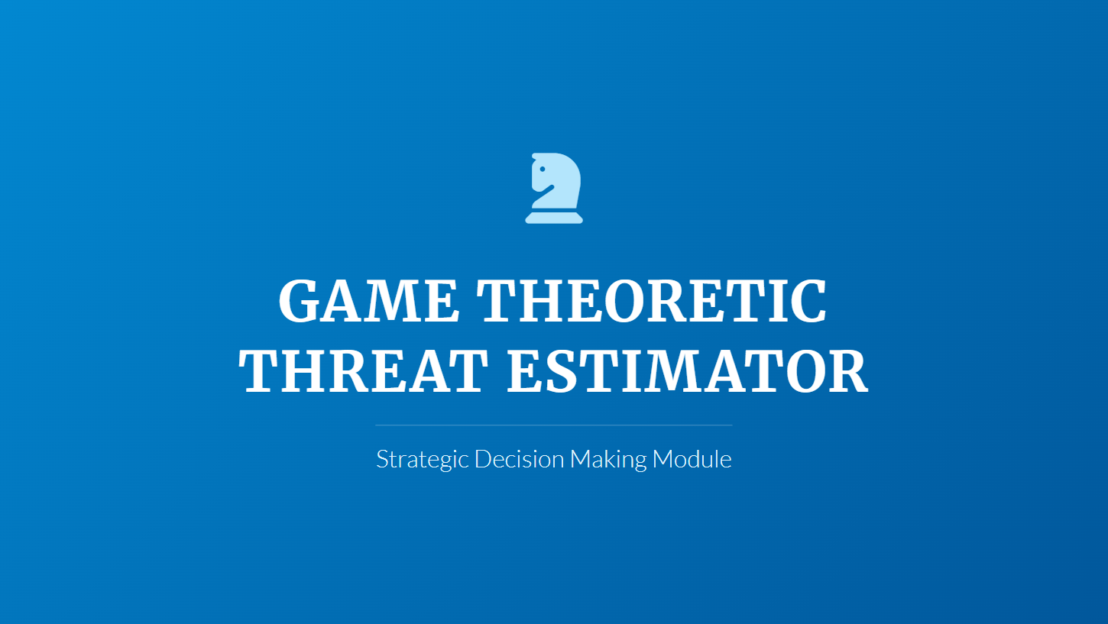

Slide 12







The Inspection Dilemma
Why can't we just use one method for everything?
Run All Layers?
Run Signature Only?
Run Sandbox Only?
(Signature + ML + Sandbox)
(Fastest Approach)
(Deepest Inspection)
Result: Extreme Latency
Result: Security Failure
Result: Resource Exhaustion
Drones require real-time decisions. Waiting for deep analysis on every packet halts the mission.
Fast, but misses Zero-Day attacks, polymorphic malware, and encrypted payloads.
Computationally impossible to simulate every single file in a high-volume drone stream.
Verdict: We need a mathematical way to choose the optimal depth → Game Theory.

Slide 13
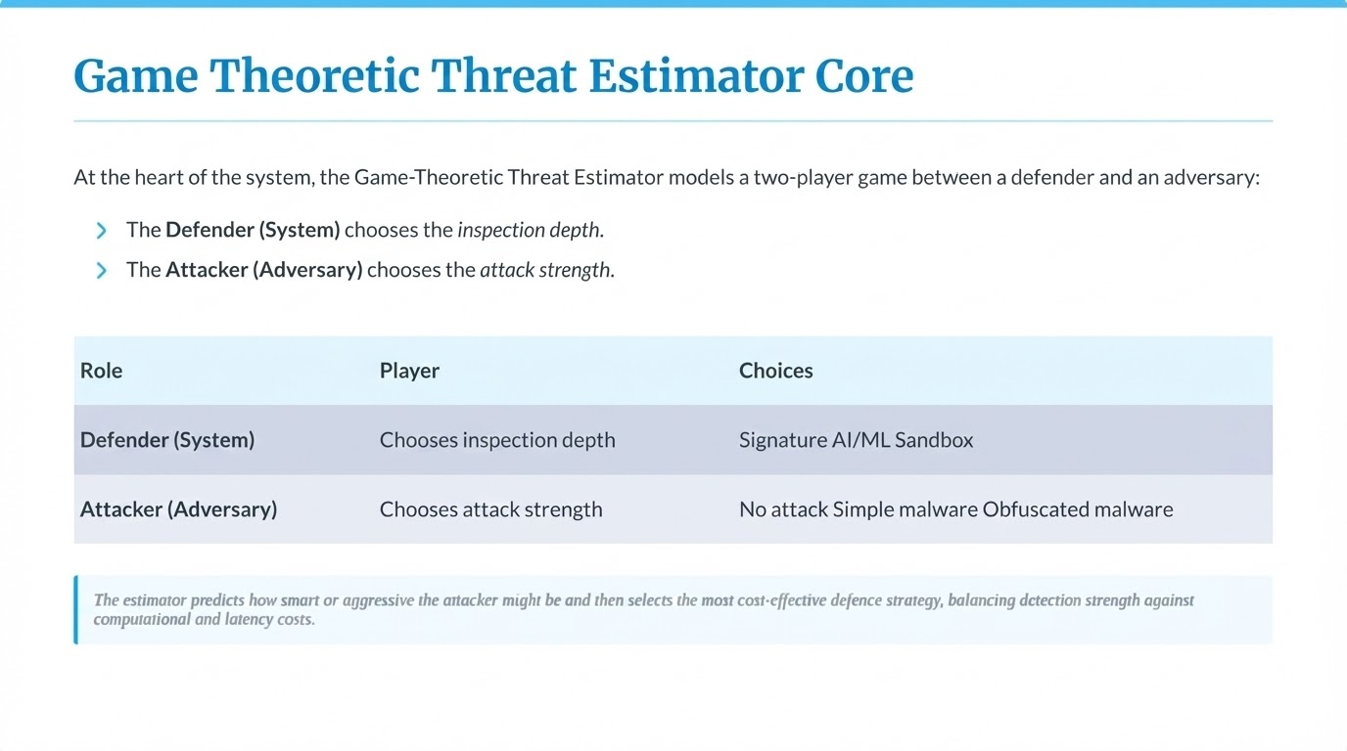

Slide 14
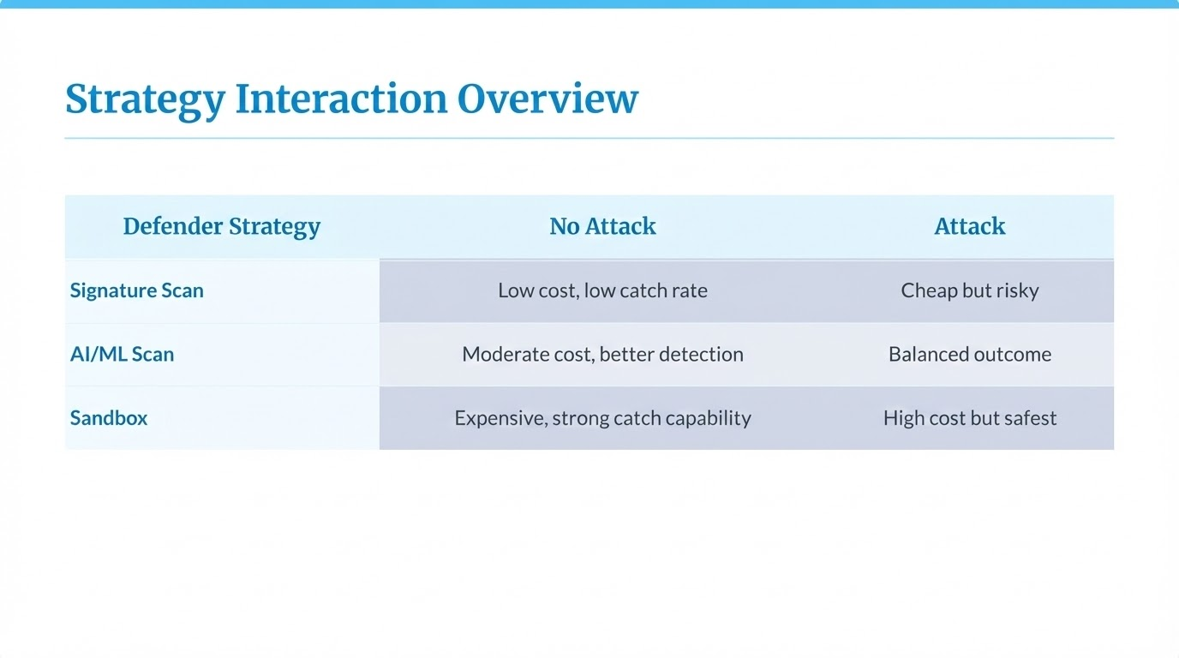

Slide 15
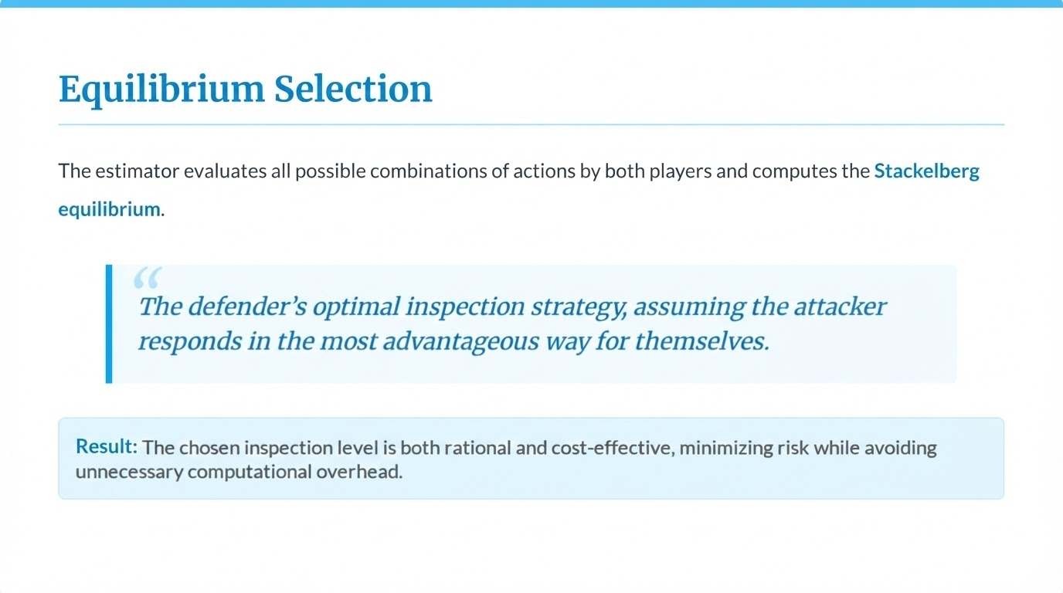

Slide 16
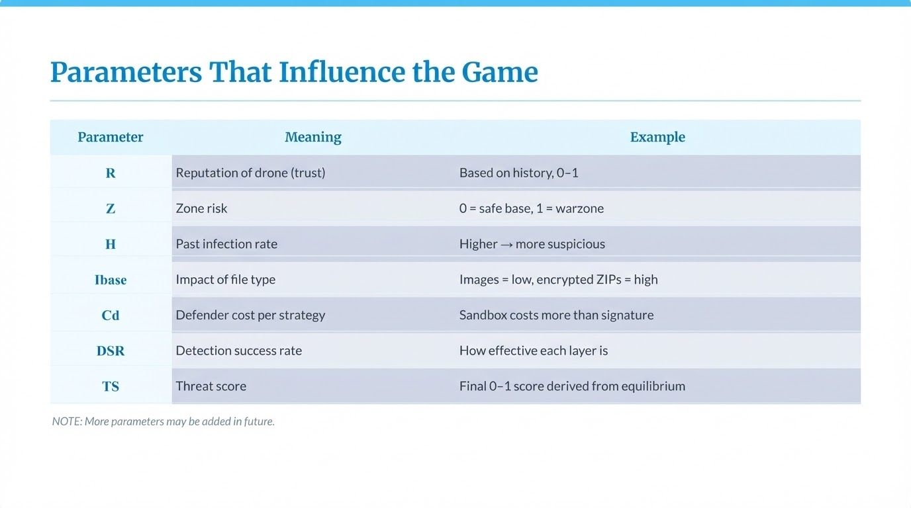

Slide 17
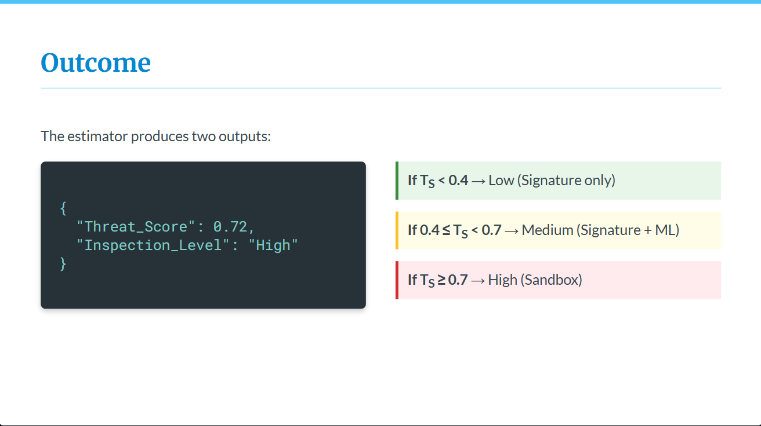

Slide 18
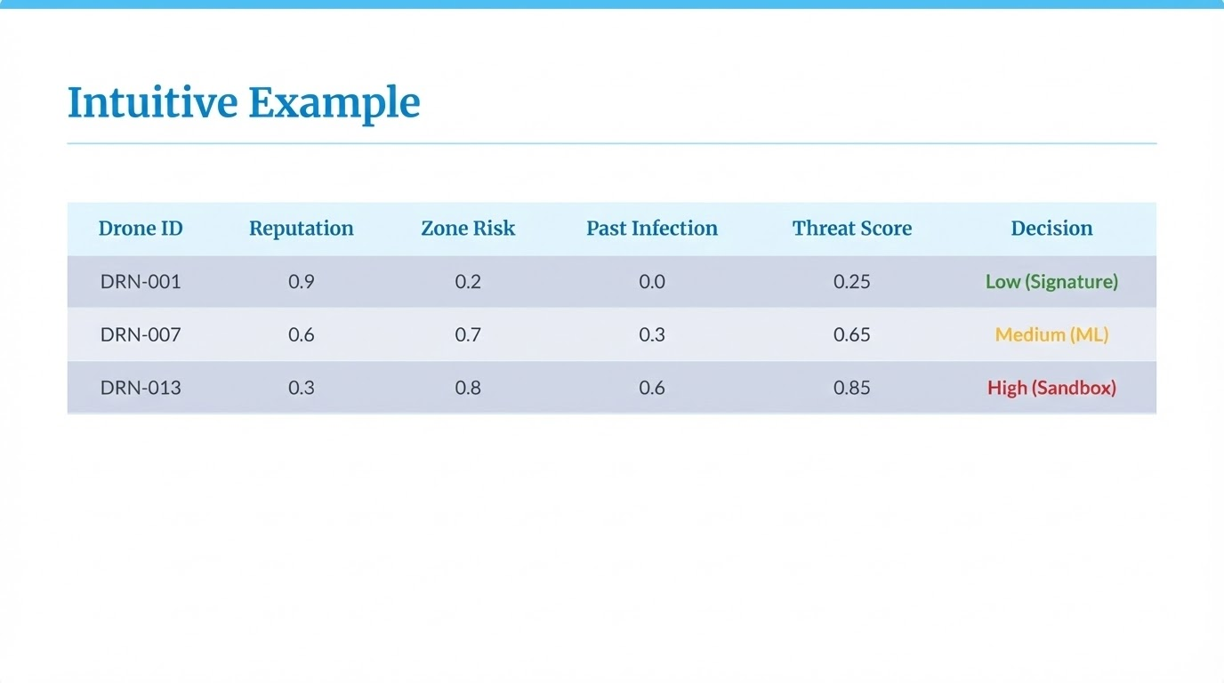

Slide 19
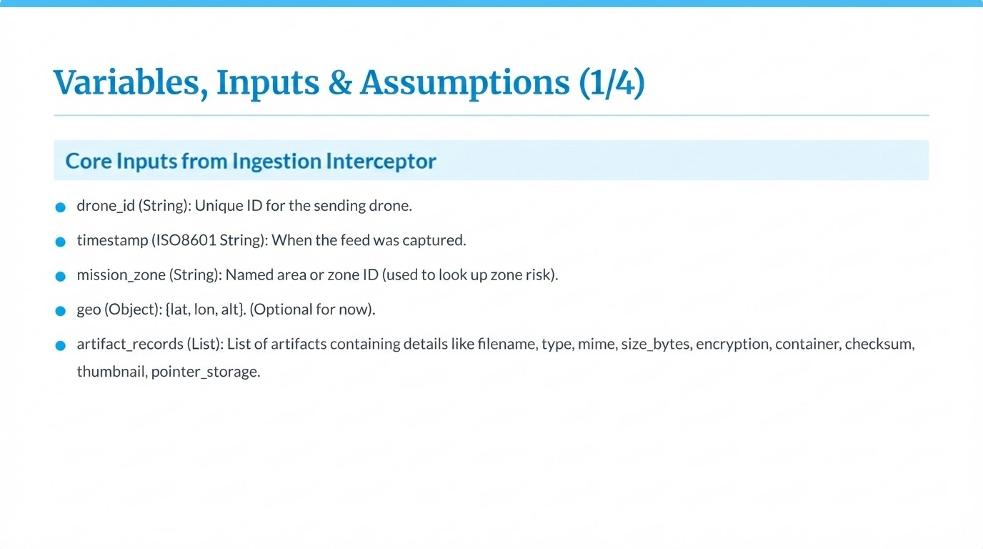

Slide 20
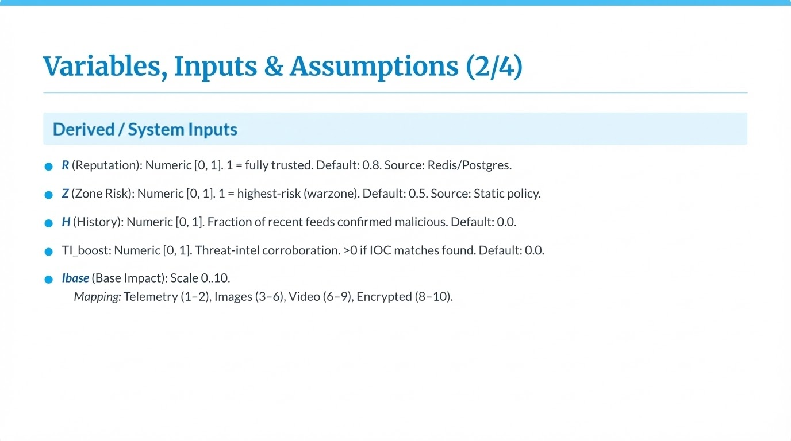

Slide 21
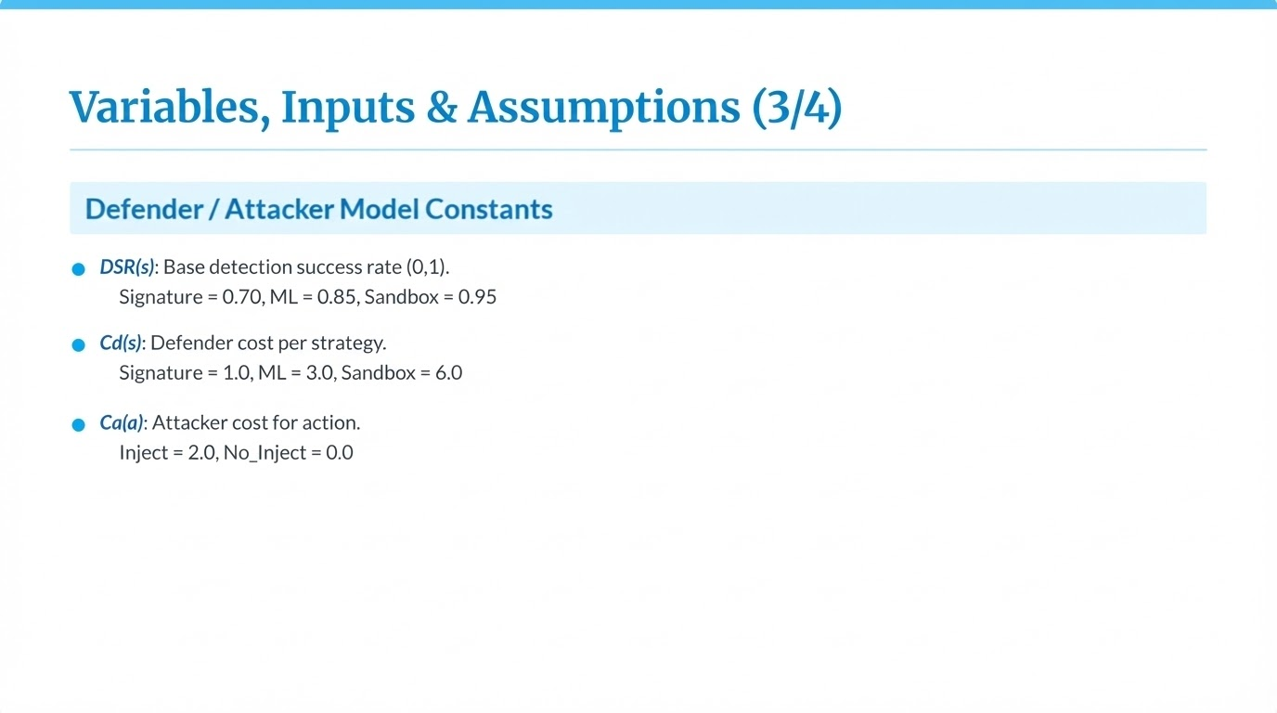

Slide 22
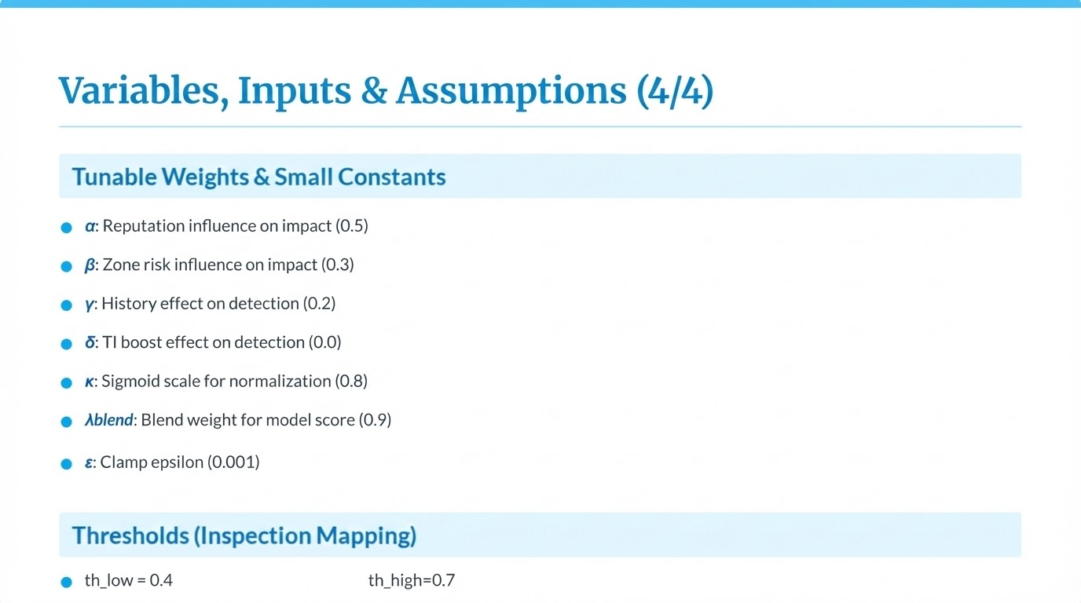

Slide 23
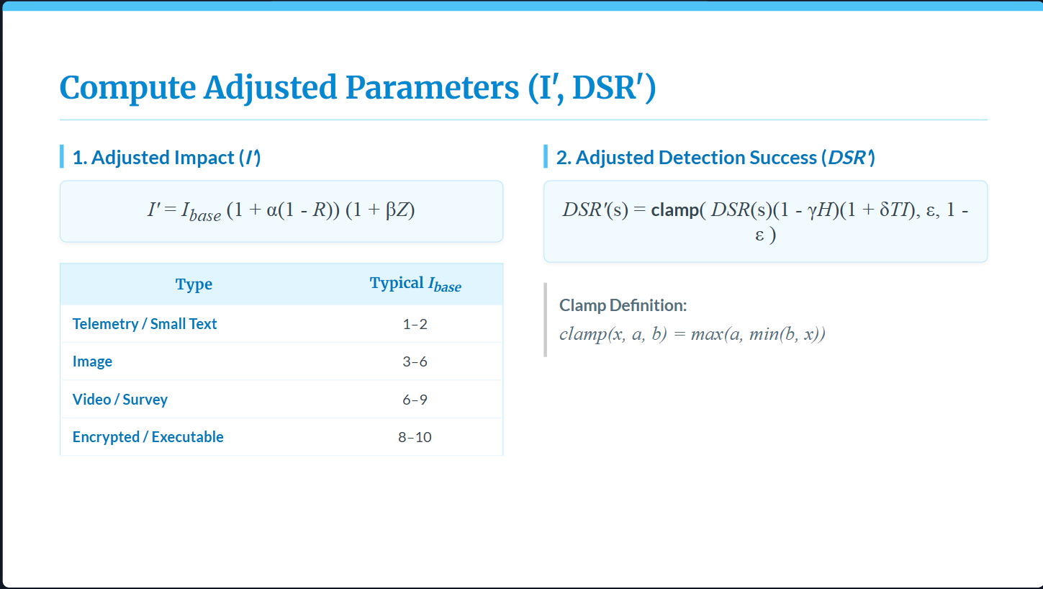

Slide 24
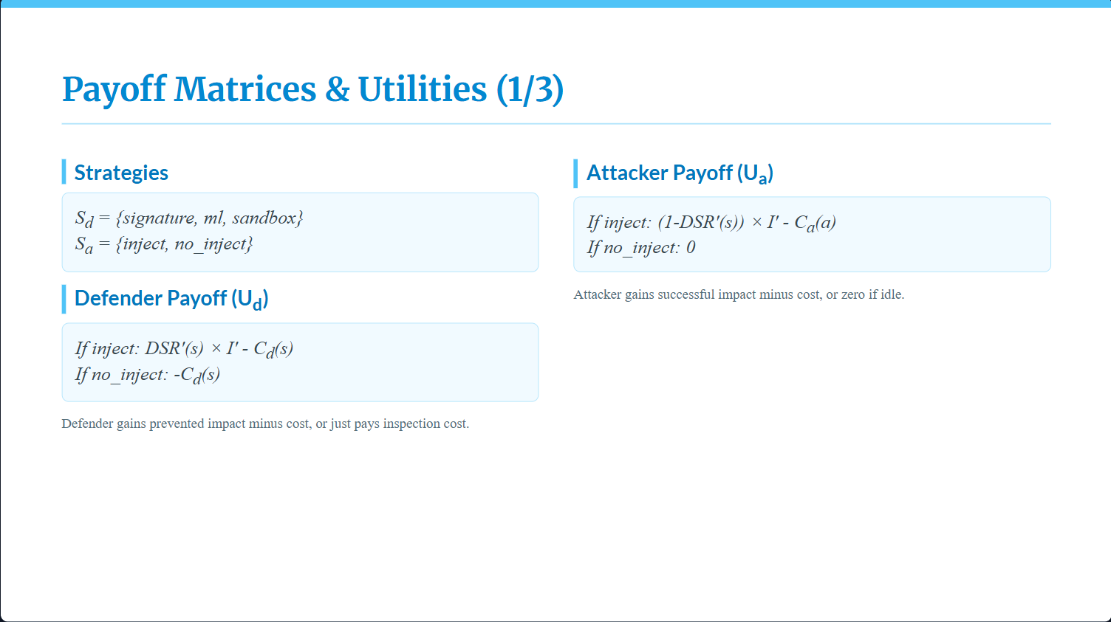

Slide 25
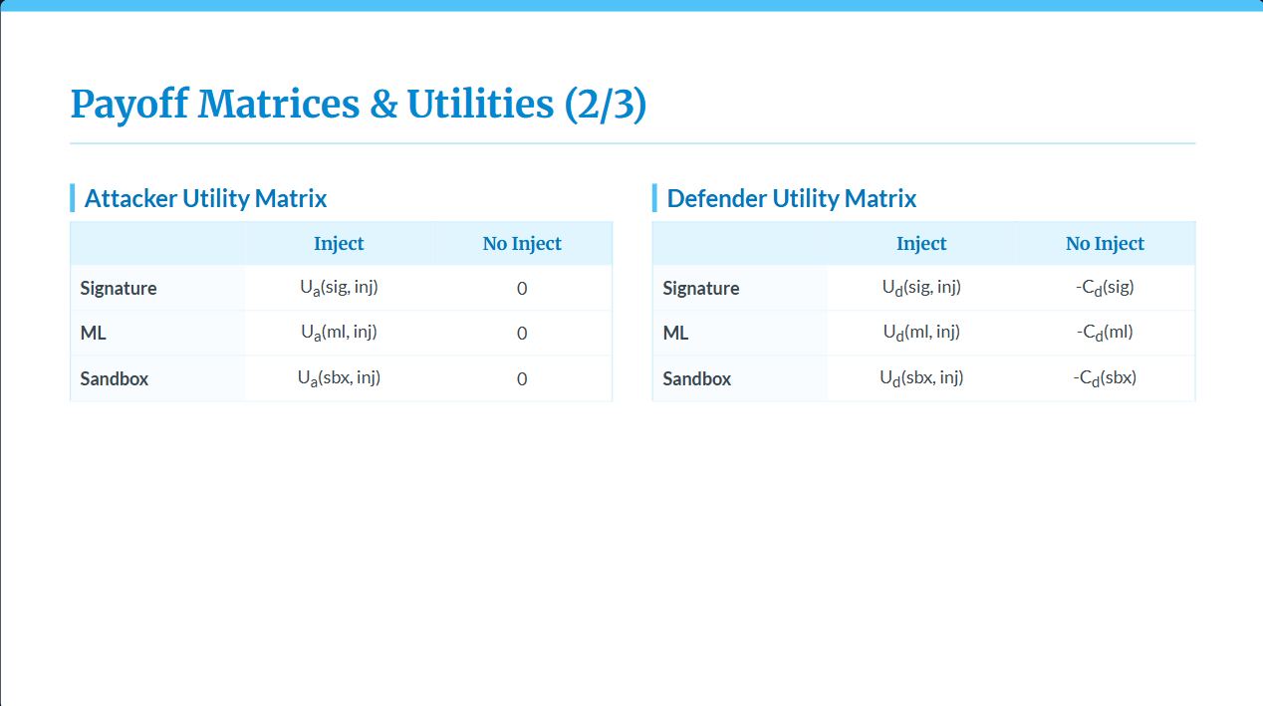

Slide 26
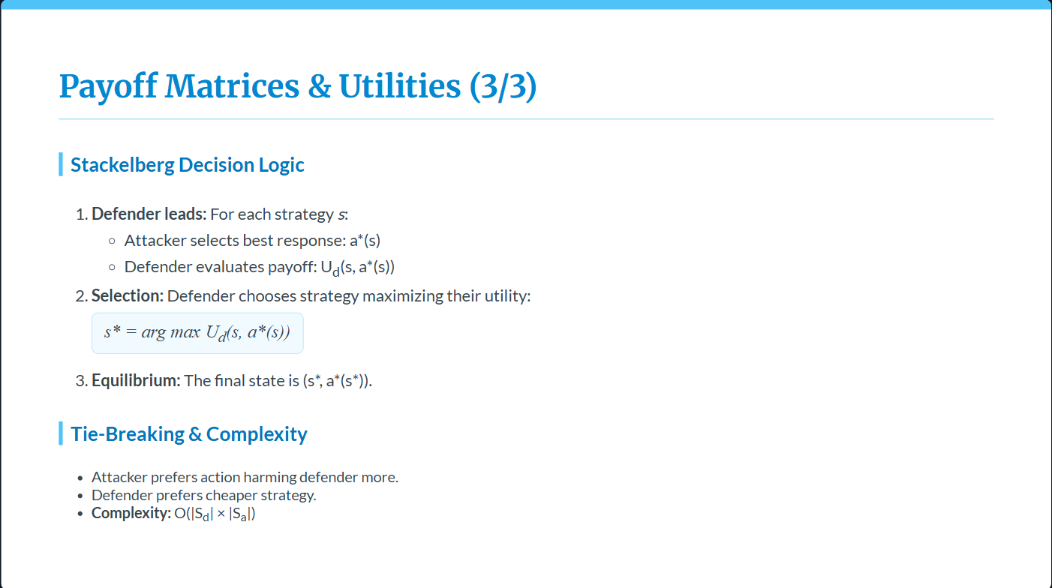

Slide 27
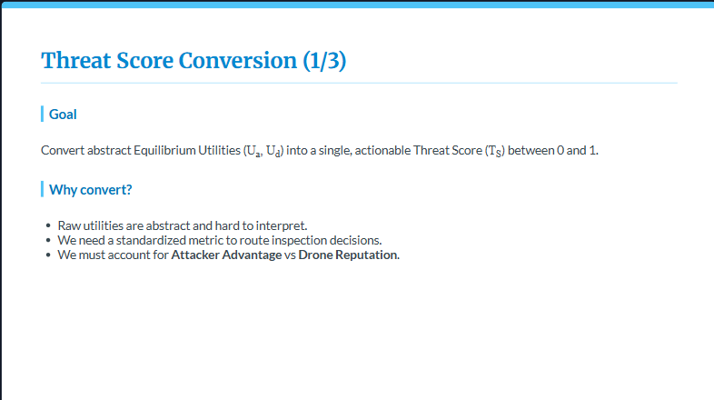

Slide 28
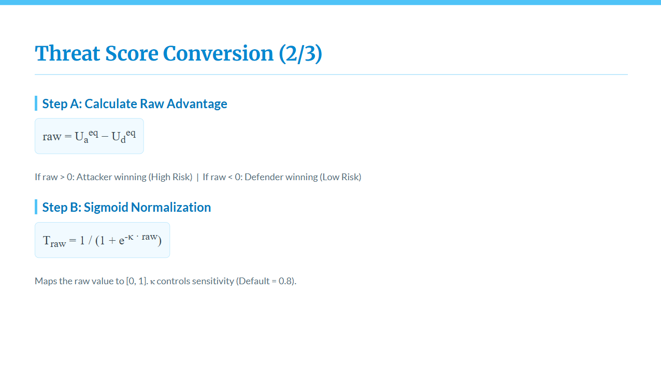

Slide 29
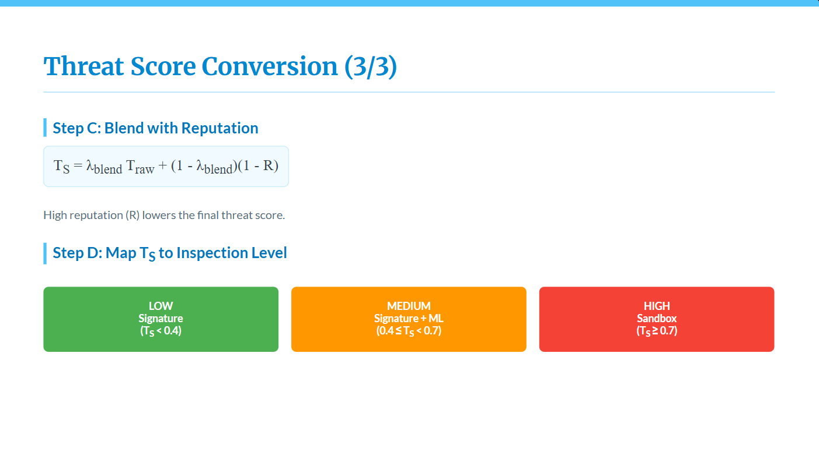

Slide 30
List of requirements for Ingestion Interceptor and Game Theoretic Threat Estimator
Language & Runtime
Python 3
Core Libraries
numpy
math
json
Data Handling
pandas
Threat Estimation / Logic
custom game-theoretic logic (Stackelberg + Bayesian attacker modeling)
sigmoid / exponential scoring functions
Ingestion & Validation
pydantic
jsonschema
File & Payload Processing
hashlib
zipfile
tarfile
Security / Integrity
cryptography (signature verification)
hashing (SHA-256)
Storage / State
Redis (reputation / history)
object storage abstraction (artifact pointers)
Testing / Debugging
Jupyter Notebook environment
logging (standard library)

Slide 31
Implementation Results
Payload Type | Risk Factors | Threat Score ($T_S$) | Verdict
Normal Video | None | 0.27 | Low (Allow)
Encrypted Nested Archive | High Opacity, Encryption | 0.83 | High (Block/Sandbox)
Large Binary | Size > 10MB | 0.61 | Medium (ML Scan)
Telemetry Data | None | 0.11 | Low (Allow)

Slide 32
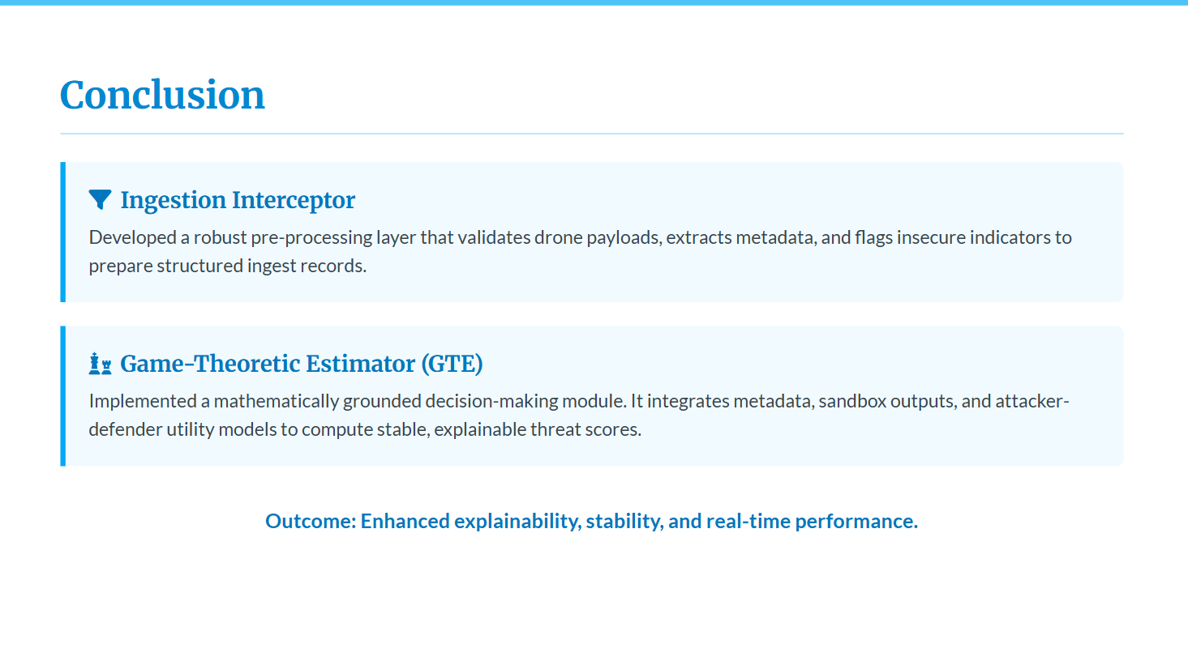

Slide 33
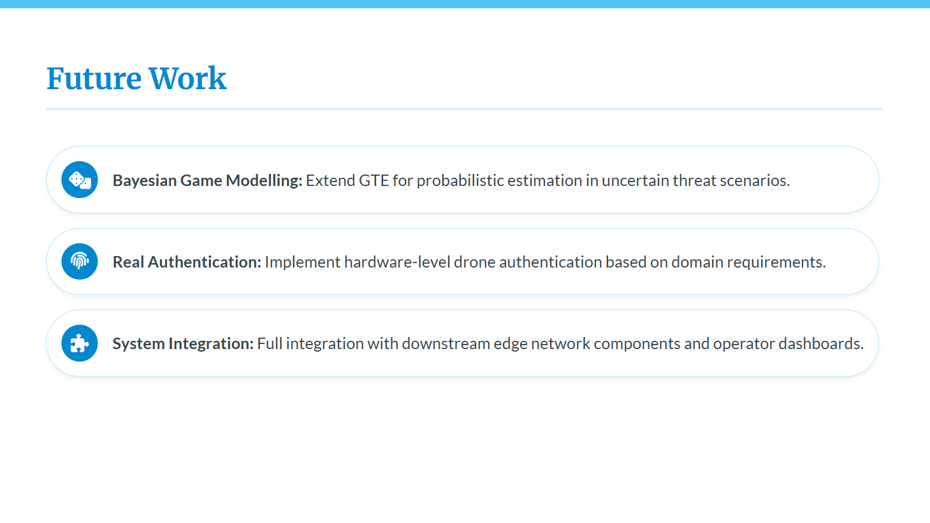

Slide 34
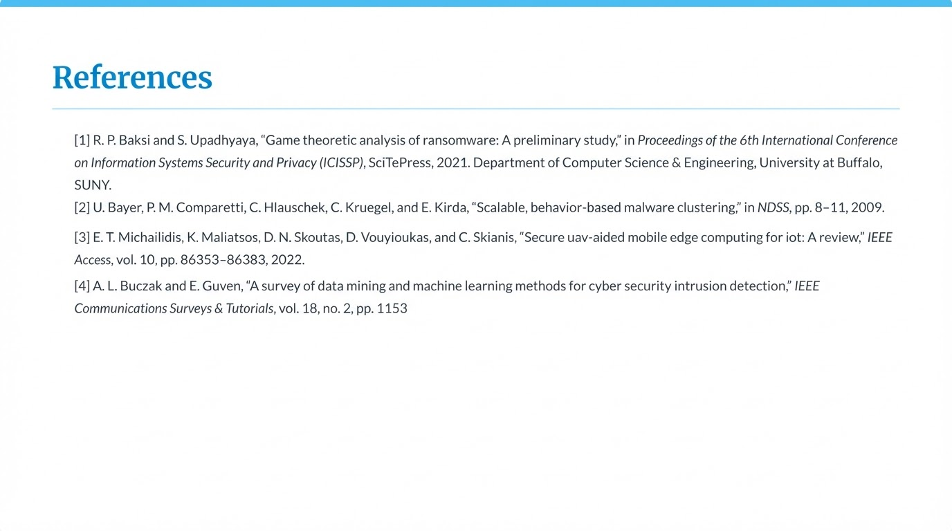

Slide 35
Questions?
Thank you for your attention.

